Slide 1

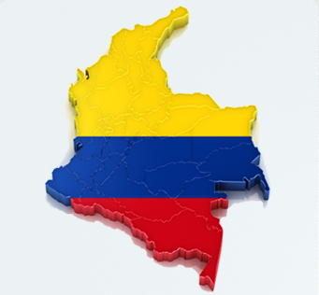
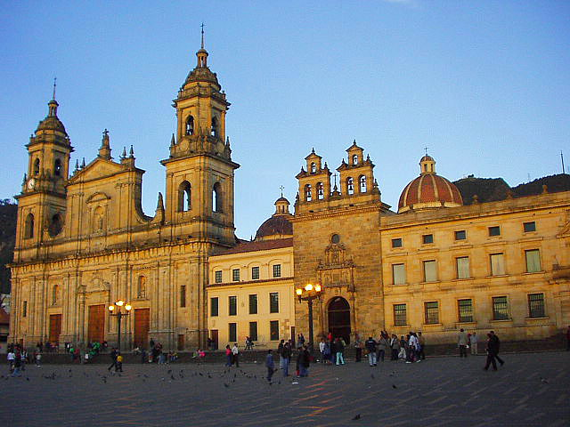
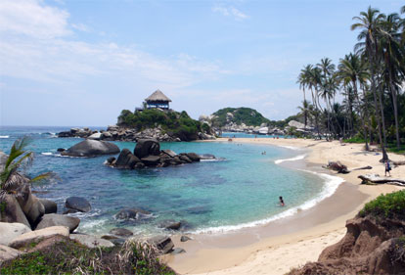
GSB
Colombia!
Hotels
Aug 23 – 31

Slide 2
Questions?
Contact:
registrations@gsbcolombiatrip.com
info@gsbcolombiatrip.com

Slide 3
GSB Colombia!
Rough itinerary…
Aug. 24 Arrive in Cartagena
Aug. 25 Explore Cartagena
Aug. 26 Isla Mucura
Aug. 27 Isla Mucura
Aug. 28 Medellin
Aug. 29 Medellin (possible day trip)
Aug. 30 Bogota
Aug. 31 Bogota
All internal flights are via private plane taken care of -- offered at cost by GSB alum!
We are planning a number of all-group activities and events, as well as small group dinners, etc. for each day!

Slide 4
GSB Colombia!
Accommodations
We have chosen a range of hotels so people can choose according to their desired experience and budget. We’ll do our best to accommodate preferences but we will have to do first-come first-served since we have limited options at each place.
We have tried to present an array of options but completely understand that these hotels may not match everyone’s preferences. You can definitely choose your own hotel if you’d prefer (there will be a place on the survey to note if you are staying elsewhere).
We have tried to stick with hotels that previous Stanford groups have used and liked…with additions to accommodate for the large size of our group!
Shared rooms will be randomly assigned (within gender) – we’ll switch it up in each location.
Couples will be assigned their own double rooms.
Some of the rooms only have double beds – so sharing a room may mean sharing a bed! If you are uncomfortable with this, please let us know and we will do our best to make other arrangements (that goes for any other needs/requests!)
All prices are per person (including SOs) per night and include breakfast

Slide 5
Hotel 3 Banderas
Trip Advisor Link
Price / Person / Night: $51
Room Type:
Total Available Rooms: 22

Slide 6
GSB Colombia!
Cartagena – Hotel Portal San Diego
Trip Advisor Link: Click Me
Price / Person / Night: $51
Room Type: Double
Total Available Rooms: 22

Slide 7
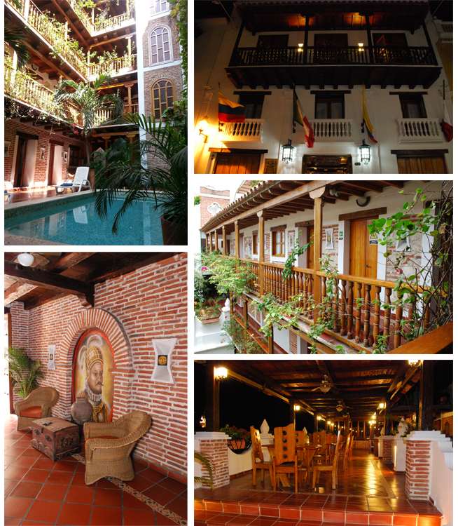
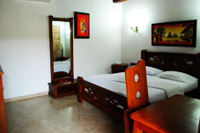
GSB Colombia!
Cartagena – Don Pedro Heredia
Trip Advisor Link: Click Me
Price / Person / Night: $64
Room Type: Double
Total Available Rooms: 40

Slide 8
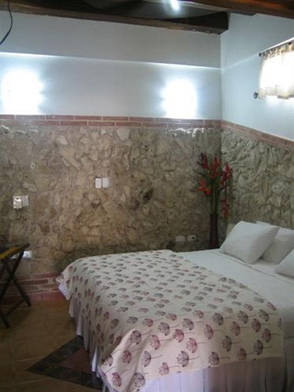
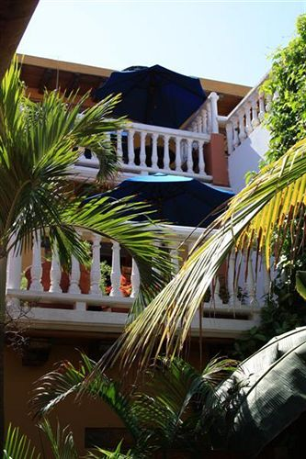
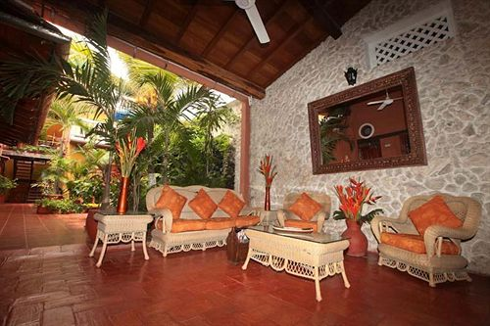
GSB Colombia!
Cartagena – Hotel 3 Banderas
Trip Advisor Link: Click Me
Price / Person / Night: $69
Room Type: Double
Total Available Rooms: 46

Slide 9
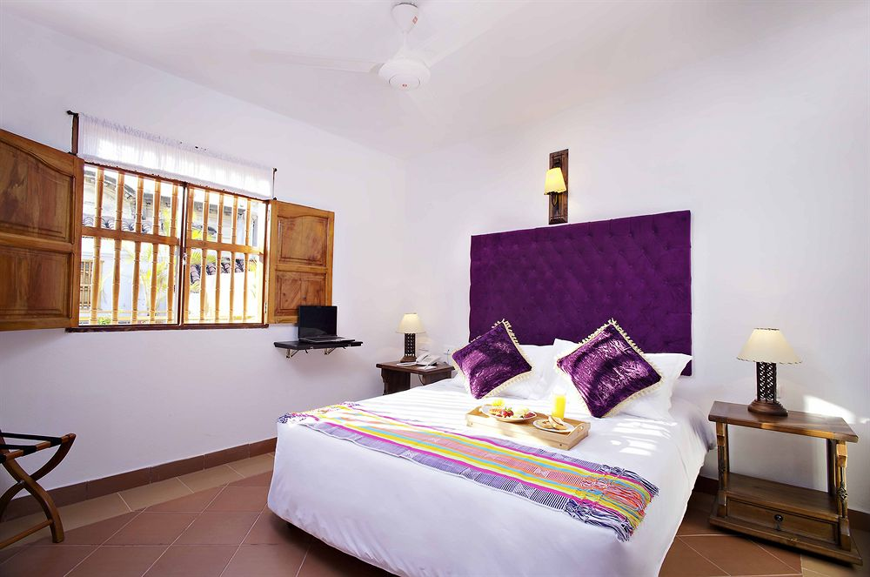
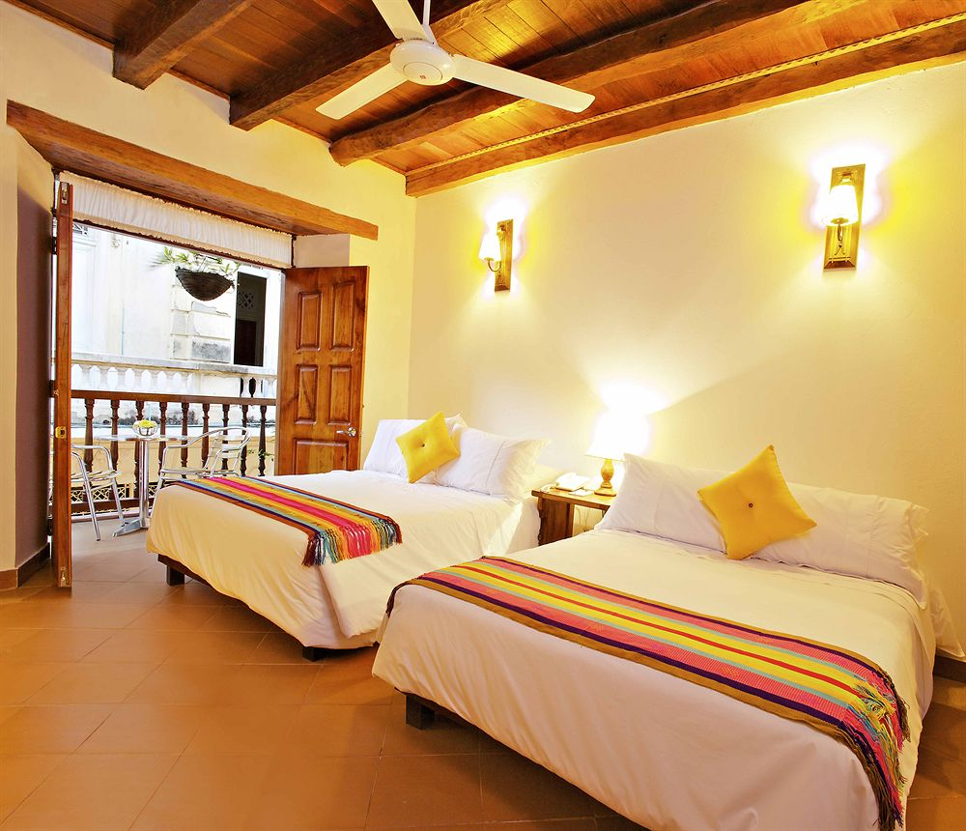
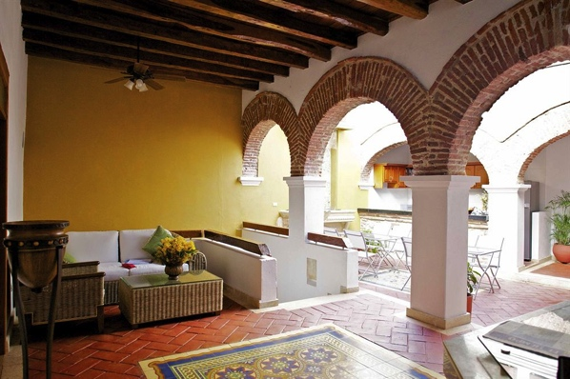
GSB Colombia!
Cartagena – Hotel Carretas
Trip Advisor Link: Click Me
Price / Person / Night: $98
Room Type: Double
Total Available Rooms: 20

Slide 10
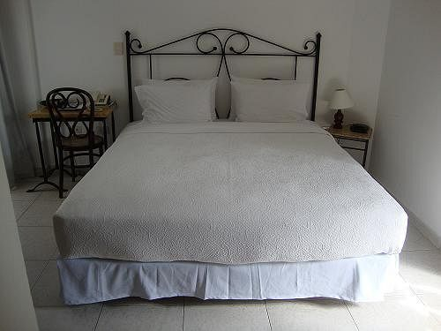
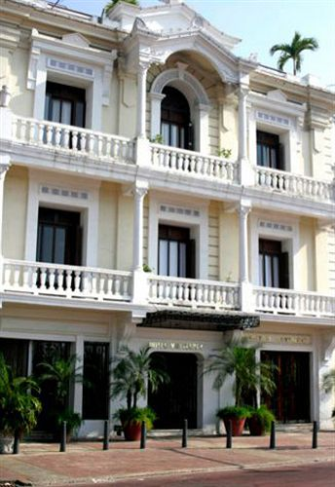
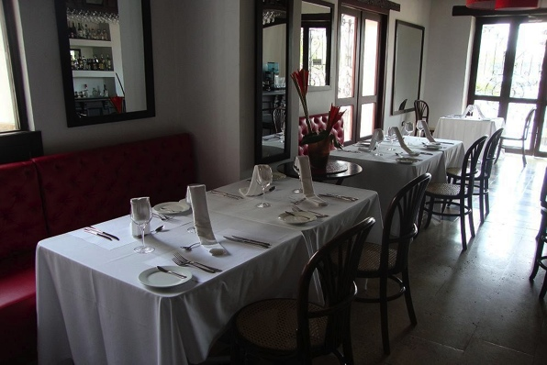
GSB Colombia!
Cartagena – Monterrey
Trip Advisor Link: Click Me
Price / Person / Night: $101
Room Type: Double
Total Available Rooms: 50

Slide 11
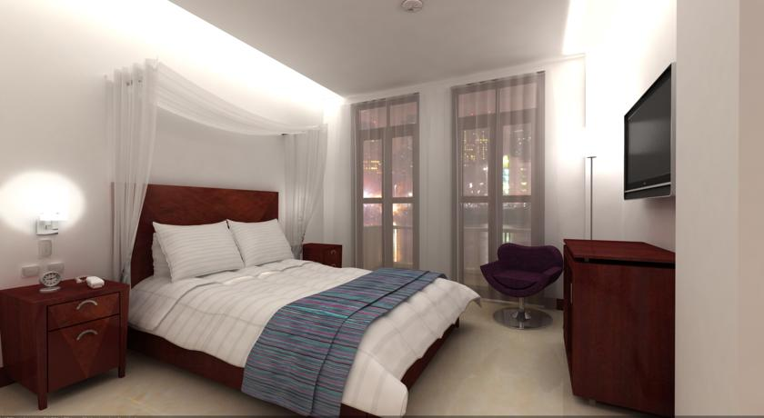
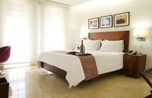
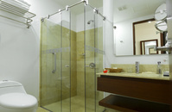
GSB Colombia!
Cartagena – Urban Royal
Trip Advisor Link: Click Me
Price / Person / Night: $115
Room Type: Double
Total Available Rooms: 8

Slide 12
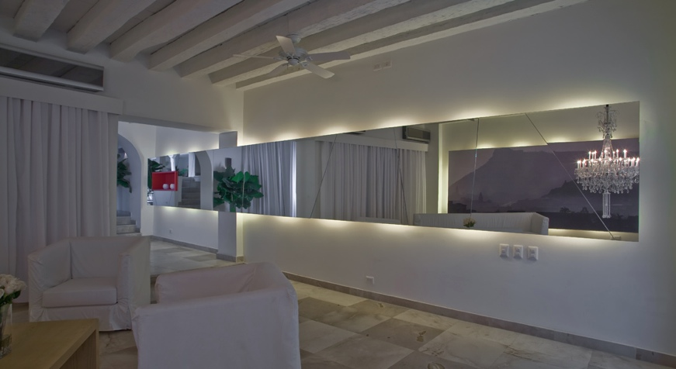
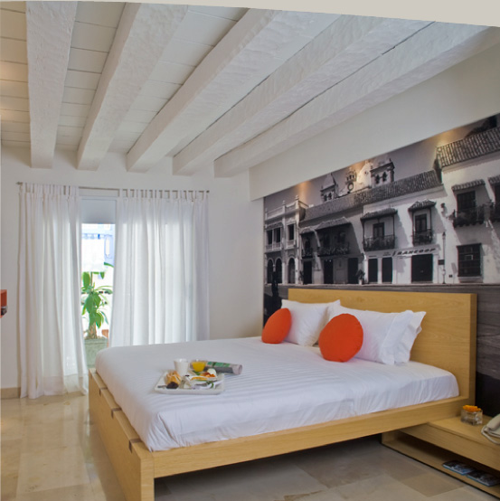
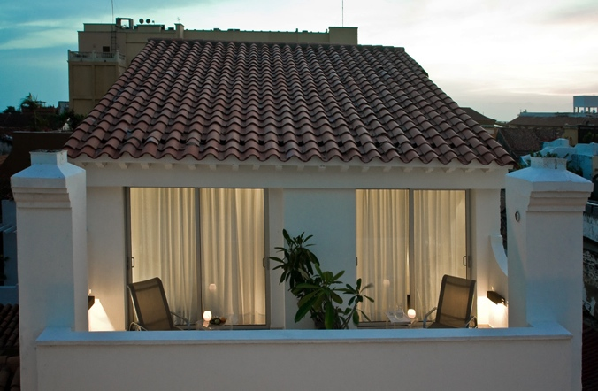
GSB Colombia!
Cartagena – Delirio
Trip Advisor Link: Click Me
Price / Person / Night: $146
Room Type: Double
Total Available Rooms: 22

Slide 13
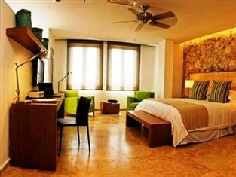
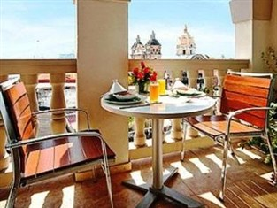
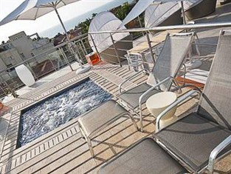
GSB Colombia!
Cartagena – Movich
Trip Advisor Link: Click Me
Price / Person / Night: $160
Room Type: Double
Total Available Rooms: 30

Slide 14
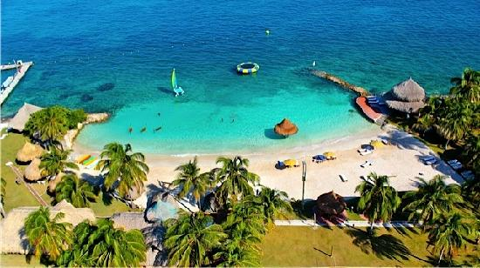
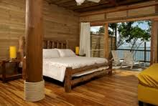
GSB Colombia!
Isla Mucura– Punta Faro
Trip Advisor Link: Click Me
Room Types & Price/Night :
Double - $190 (26 available)
Triple - $175 (9 available)
Quad - $150 (52 available)
Alt Quad - $140 (32 available)
Quint - $110 (115 available)
Alt Quint - $100 (10 available)
*Note Punta Faro is the only housing
option for Isla Mucura

Slide 15
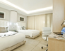
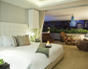
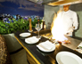
GSB Colombia!
Medellin– Hotel Charlee
Trip Advisor Link: Click Me
Room Types & Price/Night :
1 Double - $185 (20 available)
2 Singles - $150 (20 available)

Slide 16
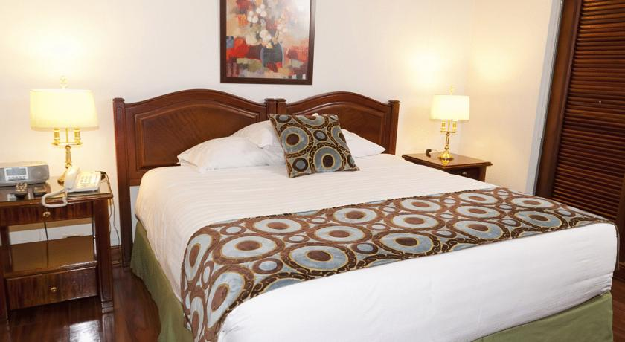
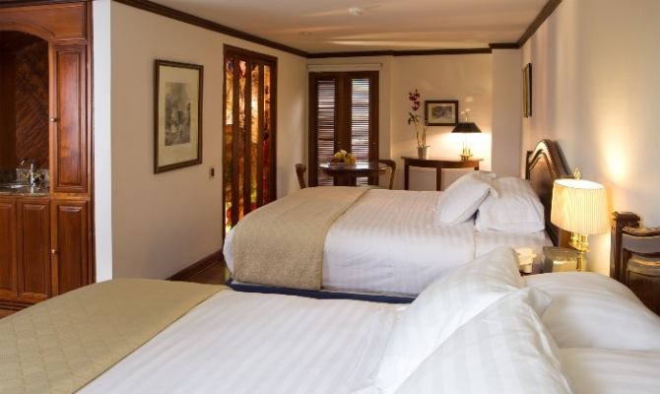
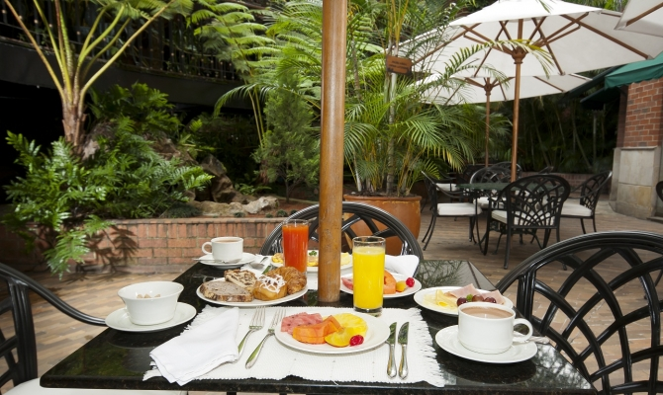
GSB Colombia!
Medellin– Hotel Park
Trip Advisor Link: Click Me
Room Types & Price/Night :
1 Double - $100 (50 available)
2 Singles - $100 (20 available)

Slide 17
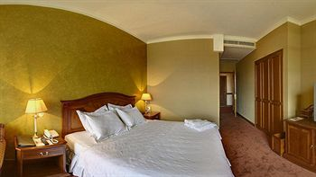
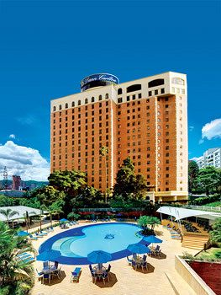
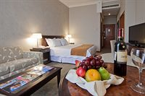
GSB Colombia!
Medellin– Hotel Dann Carlton
Trip Advisor Link: Click Me
Room Types & Price/Night :
1 Double - $95 (40 available)
2 Singles - $95 (30 available)

Slide 18
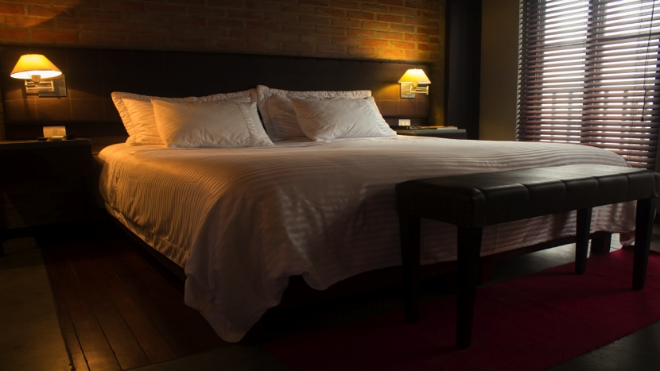
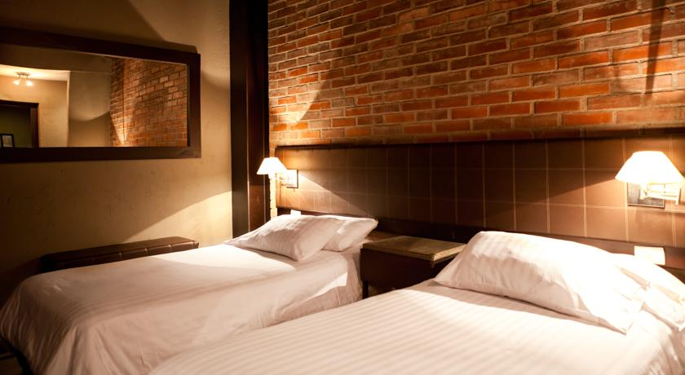
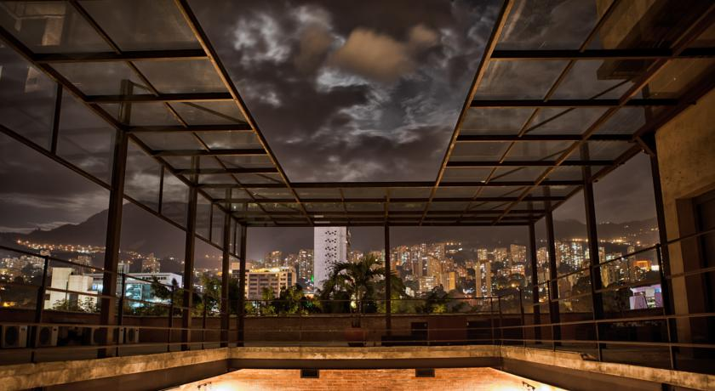
GSB Colombia!
Medellin– Hotel Art
Trip Advisor Link: Click Me
Room Types & Price/Night :
1 Double - $65 (20 available)
2 Singles - $65 (60 available)

Slide 19
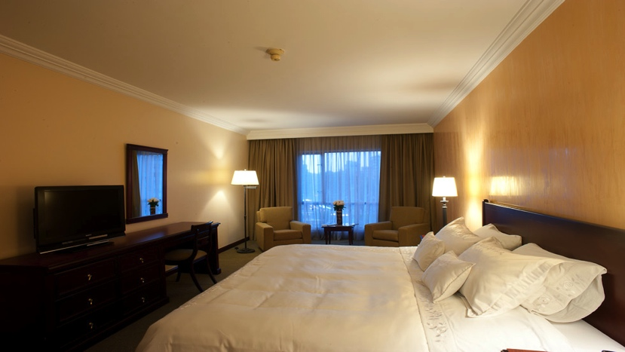
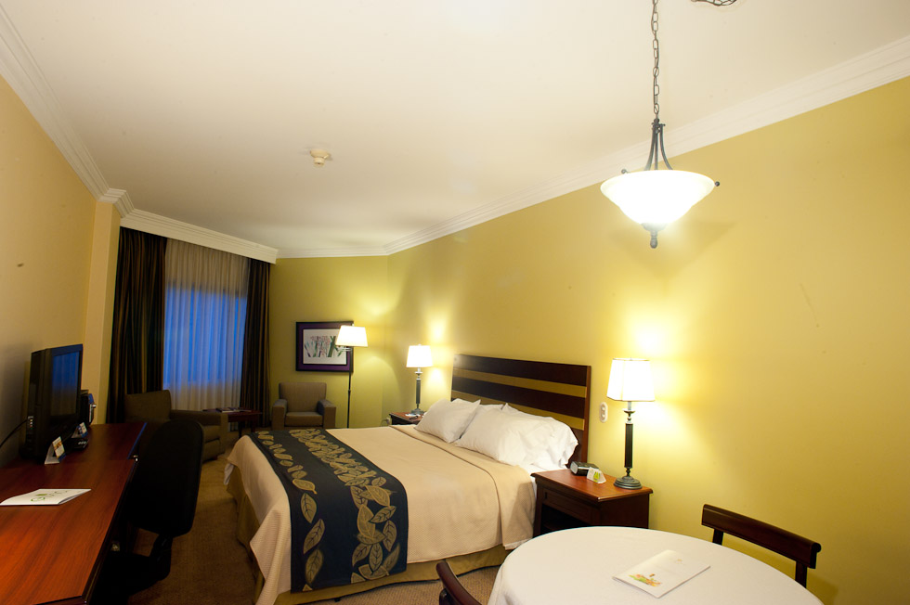
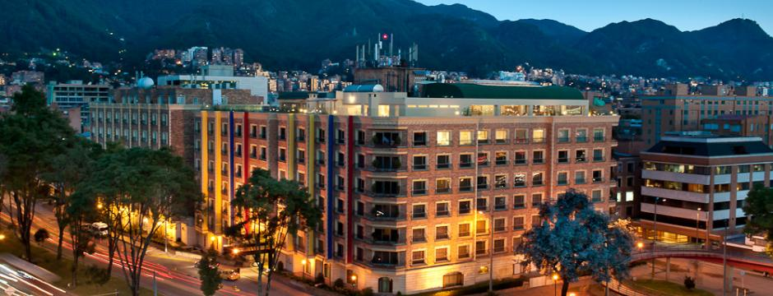
GSB Colombia!
Bogotá– Casa Dann Carlton
Trip Advisor Link: Click Me
Price : $75/night
*Note this is the only hotel choice for Bogotá

Slide 20
Hotel 3 banderas
Trip Advisor Link
Price / Person / Night: $51
Room Type:
Total Available Rooms: 22

Slide 21
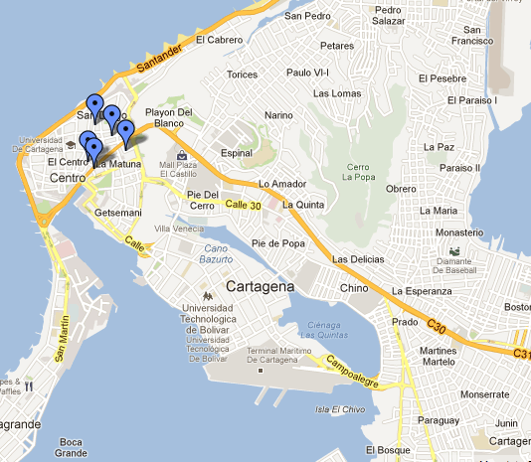
GSB Colombia!
Cartagena
A: Casa Don Sancho (http://www.colombiatravelab.com/
casadonsancho/casadonsancho-en.php)
B: Bantu Hotel
(www.bantuhotel.com/en)
C: Casa Curato
3 Banderas
(www.casacurato.com/
www.hotel3banderas.com )
D: Hotel Centro Cartagena (http://centrohotelcartagena.com.co/)
E: Hotel Stil Cartagena

Slide 22
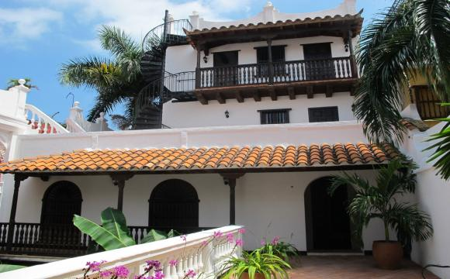
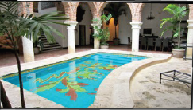
GSB Colombia!
Cartagena - A: Casa Don Sancho
Luxury choice that past classes have loved – usually fills up first!
Colonial Cartagena Mansion
Description: Divided into four floors and a rooftop terrace. First floor: imposing entrance of the house; imperial dining and a living room facing the swimming pool, surrounded by typical colonial arches and columns; large kitchen
Second floor: most of the nine bedrooms; great corridors with wooden verandas overlooking the pool and a majestic living room with colonial furniture; elegant chandeliers and balconies overlooking the colonial streets of the old city.
Third floor: solarium with spectacular views of the city, tropical plants and sunbathing chairs
Fourth floor: rooftop terrace with incredible views of the old city.
205/person, room for 20 people

Slide 23
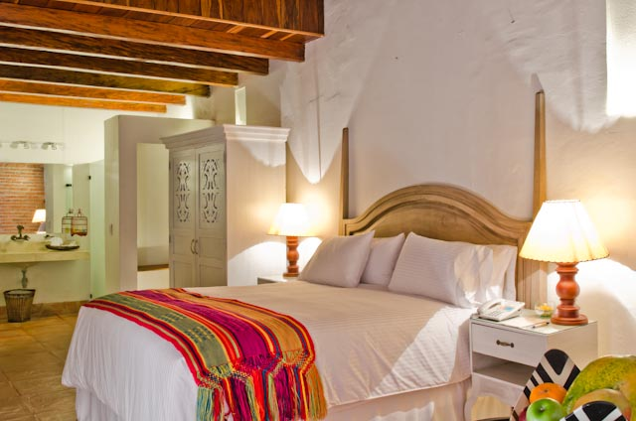
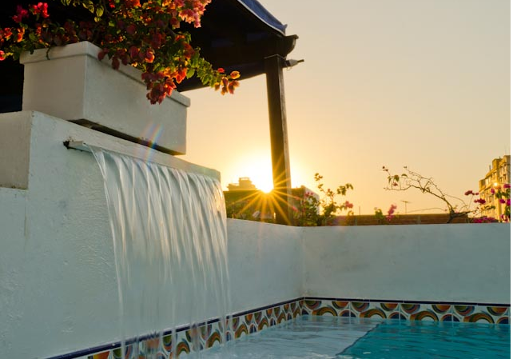
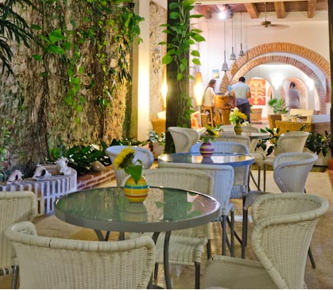
GSB Colombia!
Cartagena - B: Hotel Bantu
Beautiful boutique hotel – slightly nicer than the “C” options
Awesome terrace with swimming pool, waterfalls, Turkish bath, colonial style courtyards
Great rooms, trendy decorations
Mix of double rooms (one double bed), triple rooms (one double bed, one single), and quadruple rooms (one double, two single beds)
Doubles: ~$120/person. Triples: ~$105/person. Quadruples: ~$95/person
Rooms for 89 people

Slide 24
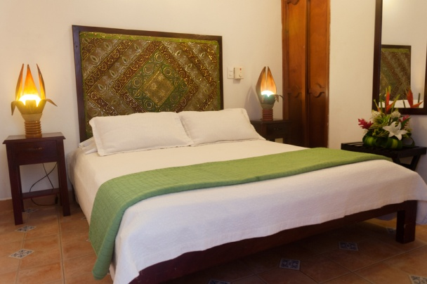
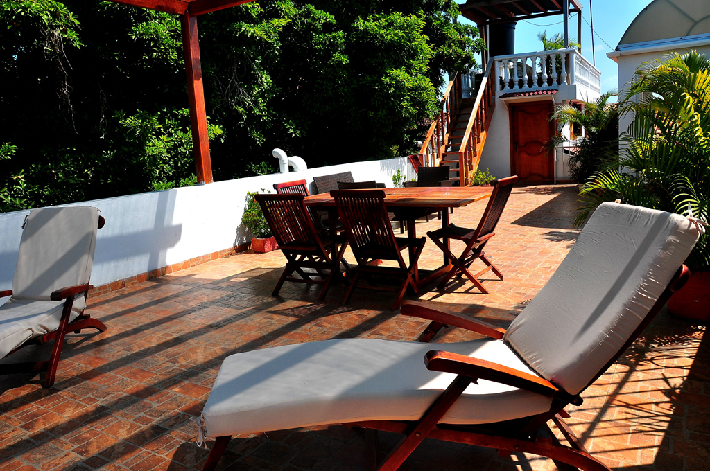
GSB Colombia!
Cartagena - C: Casa Curato
This is a new hotel this year but comes highly recommended! Slightly nicer than the other mid-tier hotels
Double and triple rooms. Doubles are ~$85/person, Triples ~$72/person
Rooms for 25 ppl

Slide 25
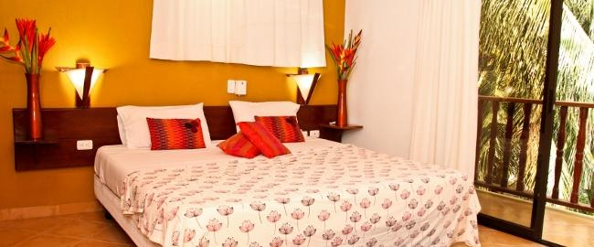
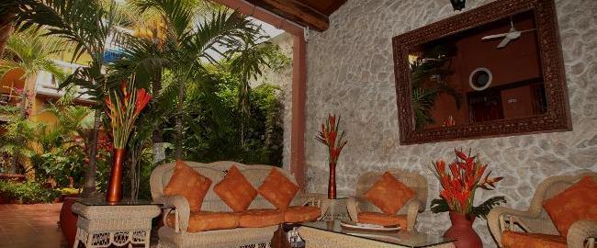

GSB Colombia!
Cartagena - C: 3 Banderas
Great value – nice mid-tier hotel similar to Curato
Full restored 200 yr old colonial house. Home-like feel, 2 indoor courtyards with fountains, free WIFI (no pool)
Doubles (one bed) and triples (one double, one single
Doubles - ~70/person, Triples ~55/person. Rooms for 56 people.

Slide 26



GSB Colombia!
Cartagena - D: Hotel Centro
New this year but highly recommended
Nothing fancy but clean, standard rooms – close to other hotels
All doubles - $61/person
Rooms for 40 ppl

Slide 27


GSB Colombia!
Cartagena - E: Hotel Stil Cartagena
New this year – we added this option to offer a lower budget hotel
In the city center, close to the other hotels
All double rooms, ~$20/person
Rooms for 150 people

Slide 28


GSB Colombia!
Isla Mucura
An amazing private island that every group has raved about in past years!
They have normal rooms for about 160 people and are finding creative ways for accommodating our huge group….
We don’t exactly know what these creative ways are but they include turning a conference hall into a big sleepover area! We’ll ask on the survey if you would be willing to pay less for what we’ll call “camping” versus a traditional room, and otherwise will decide based on first-come, first-served
Prices (around $220/person for a regular room and $180 for “camping”) include: all meals and non-alcoholic drinks, and a happy hour
Activities includes snorkeling, yoga, massage, windsurfing, diving, kayaks…

Slide 29

GSB Colombia!
Medellin
A: Charlee Hotel: www.thecharlee.com
B: Hotel Art Medellin: www.arthotel.com.co
C: Hotel Rosa Plaza: www.pobladohotels.com

Slide 30




GSB Colombia!
Medellin - A: Charlee Hotel
Beautiful hotel with luxurious rooms – we got it for a great deal (the owner is a friend of a Stanford alum). If you are going to stay in one nice hotel for the trip, this would be it!
Features a rooftop pool and bar (and a second bar in the pool!) that will be our nightly convening spot for the whole group, so you won’t have to travel!
Rooms for 2 and 4 people, priced differently (see below). Rooms for 88 people.
2 Double beds – 4 ppl ($77/person)
Double King – 2 ppl ($109/person)
Double King AQUA ($144/person)
Amazing rooftop pool and bar!

Slide 31


GSB Colombia!
Medellin - B: Hotel Art Medellin
Nice, comfortable, artistic hotel with wifi, gym, bar, art gallery
Great reviews from last year’s group!
Almost all rooms are doubles with two single beds (can be combined) to make a double
~$65/person for each room
Rooms for 108 people

Slide 32

GSB Colombia!
Medellin - C: Hotel Plaza Rosa
New hotel this year – good lower budget option close by
All double rooms, mix of double beds and two singles
~$40/person
Rooms for 100 people

Slide 33


GSB Colombia!
Bogota
We are all staying together in Casa Dann Carlton!
All double rooms
~75/person

